Slide 1
Image Sensor Testing and Characterization.
Presentation Prepared for the Staff of
Nelcor/Tyco Health Care
Presented By: Nick Nickols, Director of Engineering, DMR LLC

Slide 2
Overview
I recently have been involved in CCD and X-ray image sensor development projects. My contributions have included:
System level and FPGA design/modification.
Characterization of Hybrid CdTe X-ray detectors.
Design, integration, certification, and release to manufacturing of a CCD camera.
Analyzing the clocking and timing of sensors as it impacts image quality in detector arrays.
Bring up/debug next generation X-ray Detector Hybrids.
Product support for manufacturing of CCD camera.

Slide 3
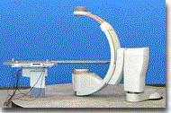
NexRay Medical
X-ray Detector Array
X-ray Source

Slide 4
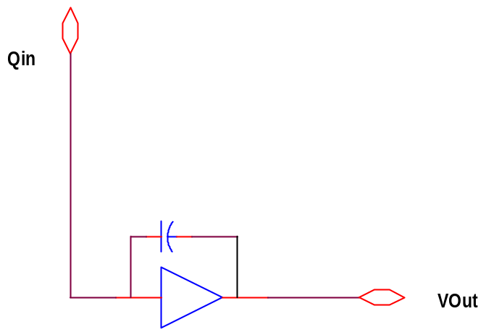
X-ray Detection with CdTe Crystals
Cadmium Telluride is a semi conducting material used in focal plane arrays and
X-ray detectors.
XRAY Photon
Bulk CdTe Crystal
+
-
+
-

Slide 5
X-ray Detector Array Construction
Electrode (Au, or Alloy)
CDTe Crystal
Bump Bonds
ASIC (Detector Electronics)

Slide 6
X-ray Detector Array
Detector is comprised of 16 Hybrid detectors.
Each hybrid detector has an array of +/- 480 charge sensitive amplifiers (Sub pixels).
The combination is an array of 7680 pixels.

Slide 7
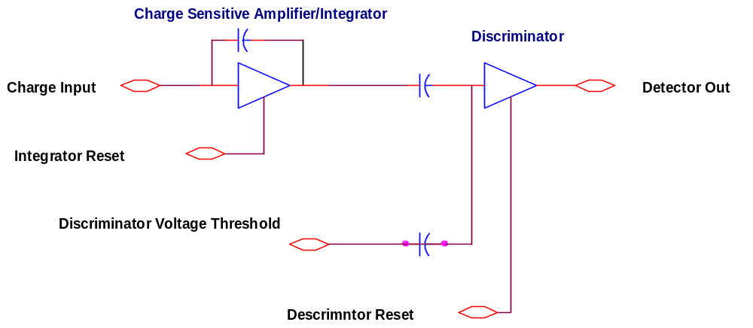
Charge Detection and Discrimination

Slide 8
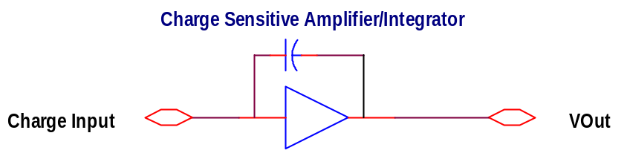
Charge Sensitive Preamplifiers
Qin
t
VOut = Qin/Cf
Qin = I(t)dt
0

Slide 9
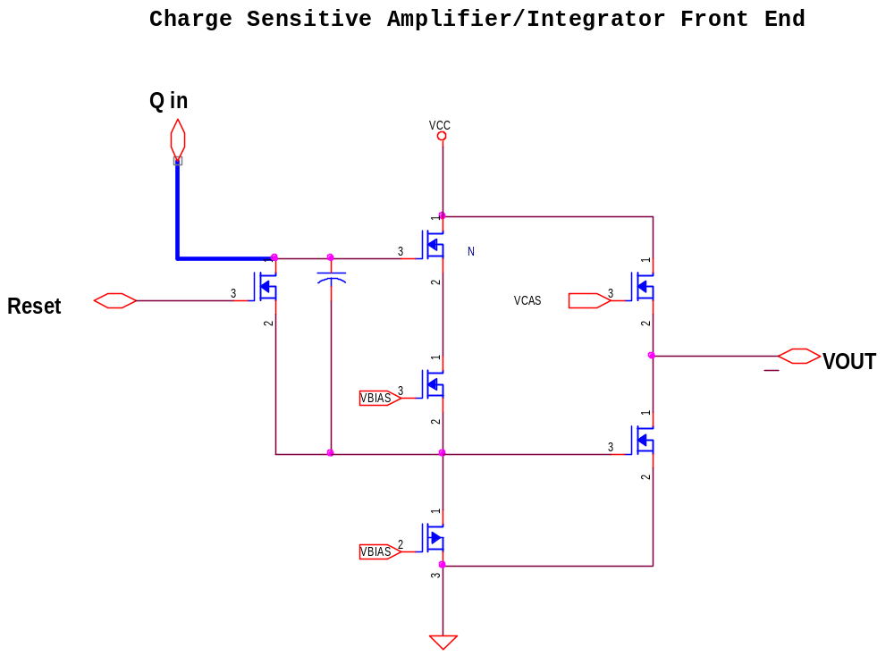
Construction of Charge Sensitive Amplifiers

Slide 10
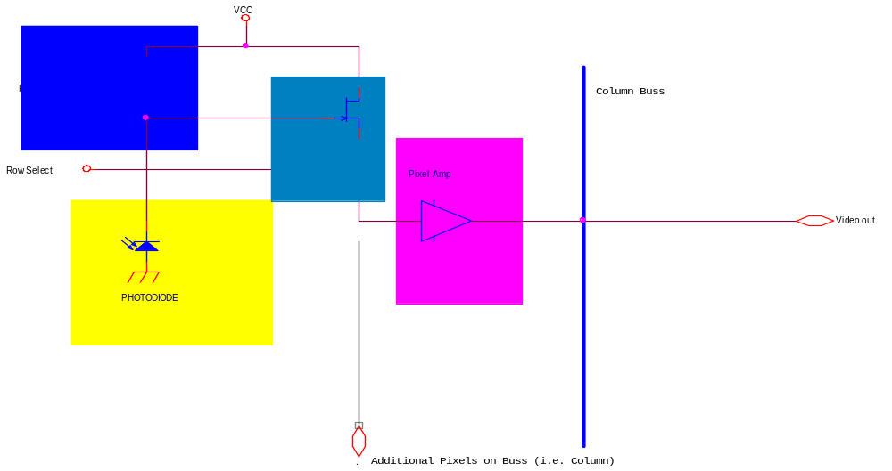
Active Pixel Sensor Front End

Slide 11
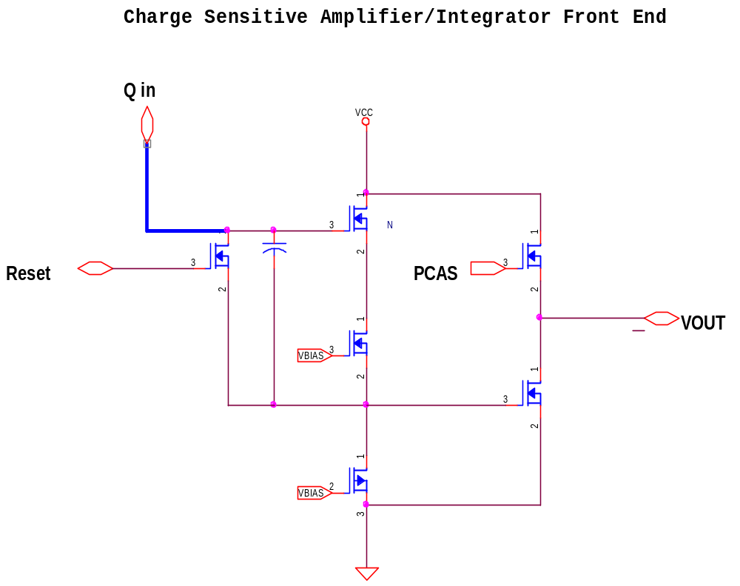
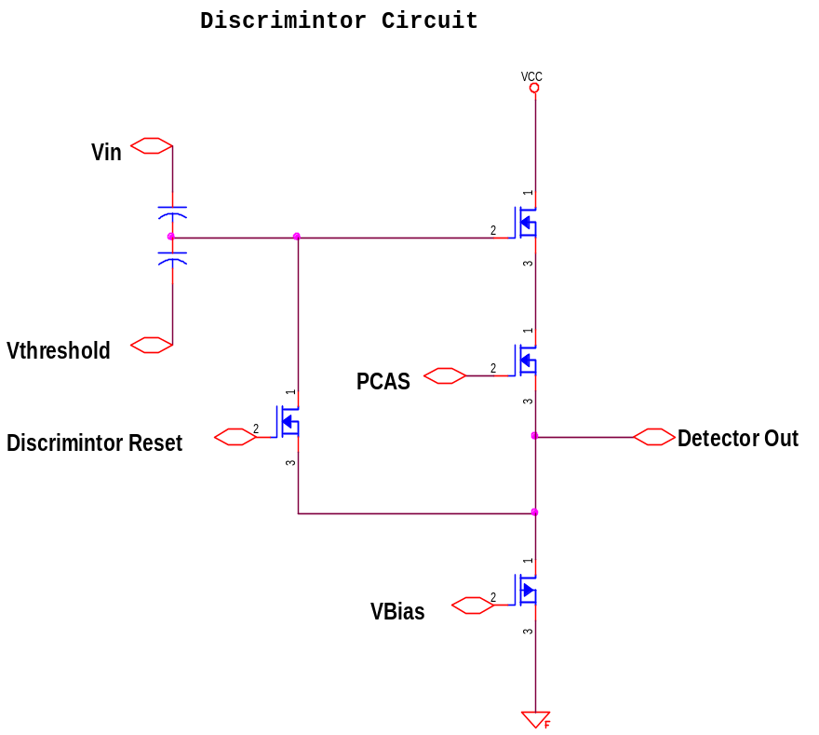
Transistor Implementation of X-Ray Detector Front End

Slide 12
Integrating the Hybrid X-Ray detector with an FPGA
Timing for each Hybrid X-ray detector controlled by a FPGA.
One can optimize the integration and discrimination timing at the front end of the detector array.
Bump bond height variations cause integrator/discriminator circuits to read slightly different charge variations under monochrome X-ray source conditions.
Modifications in FPGA timing can be used to equalize out some of these variations.

Slide 13
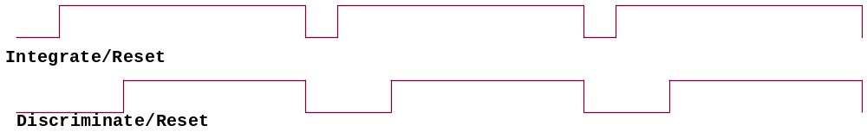
FPGA Timing Model(simplified)

Slide 14
Detector Testing
High Speed data capture
X-ray Filter
Detector Array
X-ray Source

Slide 15
Experiments for characterizing detector hybrids
Compared pixels variations under:
Varying X-ray Illumination levels. Quantified Poisson excess noise.
Swept V threshold of Discriminator for each X-ray illumination level.
Altered FPGA timing on each hybrid; attempting to equalize for variations in detection elements.
Ran experiments to capture turn on time and impulse response to pixel (charge sensitive amplifier) without an X-ray source.
This mapped variations in Bump Bond Heights.

Slide 16
Results of Hybrid Characterization
Determined Optimal FPGA timing for each hybrid.
Determined Optimal Voltage threshold values for each hybrid.
Characterized the X-ray sensitivity boundaries.
Determined Poisson Excess noise sources and validated noise models.
Characterized manufacturing and construction processes of several CdTe and Bump Bonding vendors.

Slide 17
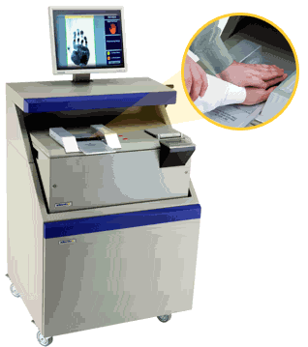
CCD Camera Design for Biometric Imaging
CCD Camera
Formally employed with Identix Inc.
Designed the CCD camera electronics for the TP3800 Imaging system.
Characterized camera and Optics for FBI appendix F certification.

Slide 18
Interline CCD Technology Simplified
Vertical Charge transfer Gate
Vertical CCD Shift Register
Photo Diodes (Pixels)
Vertical Column Registers Shift in Parallel
Horizontal Charge transfer Gate
Horizontal CCD Shift Register
Pixel Buffer
Horizontal Pixels Shift Horizontally.

Slide 19
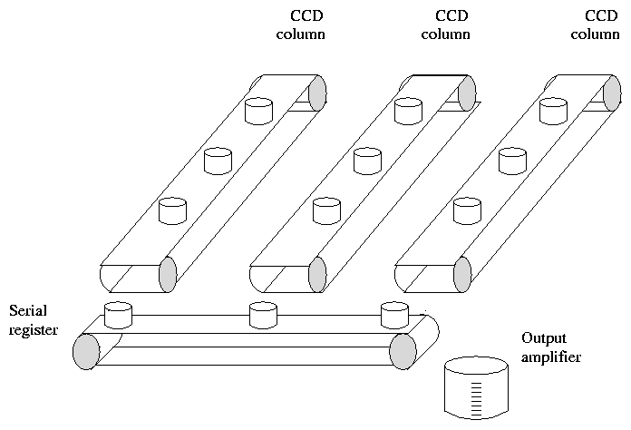
Charge Integration Analogy

Slide 20
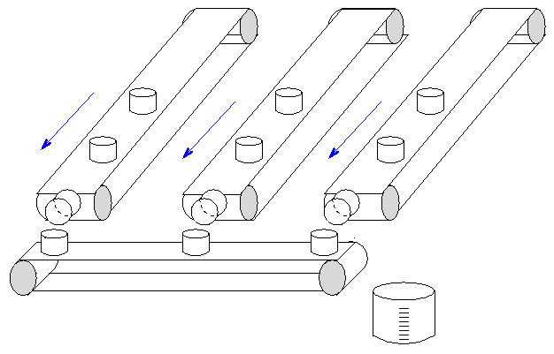
Charge Transfer Analogy

Slide 21
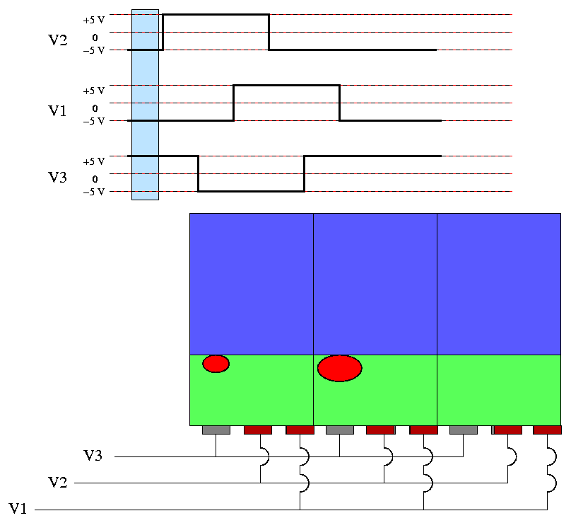
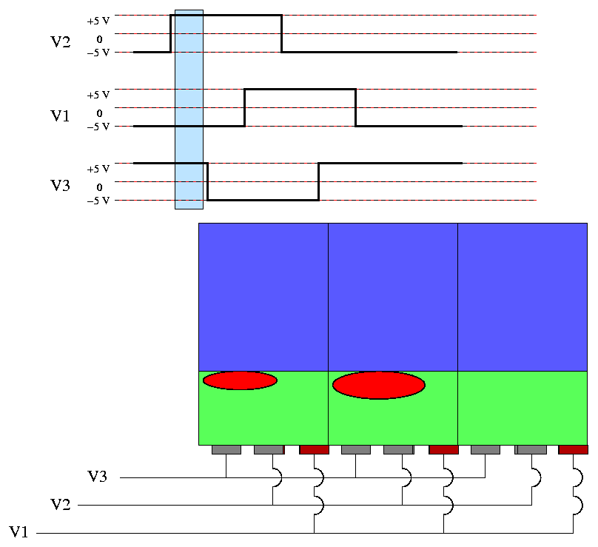
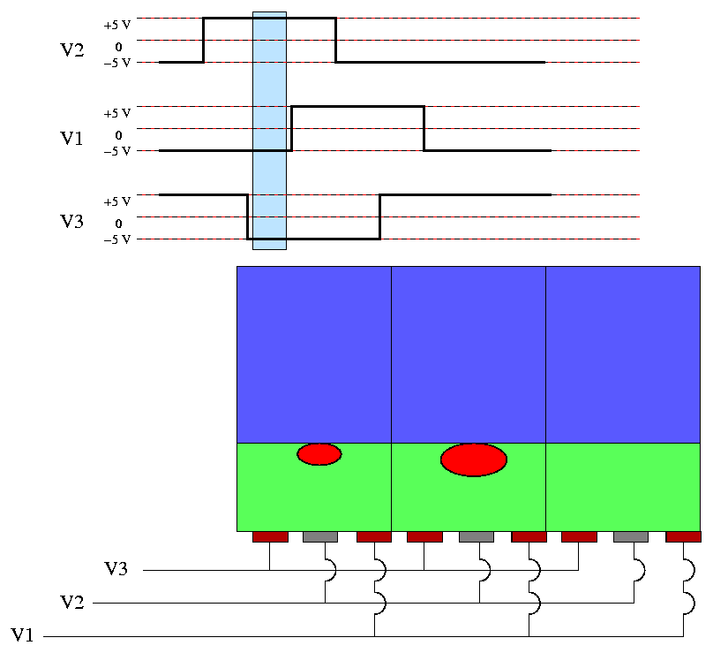
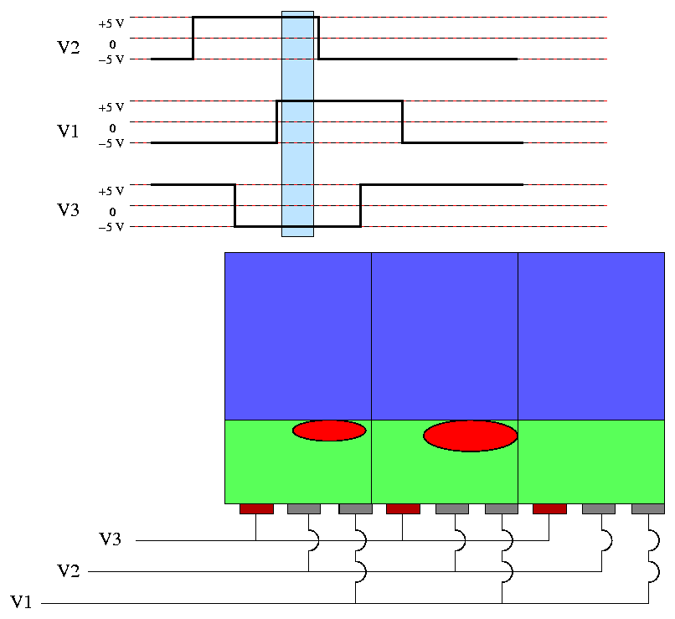
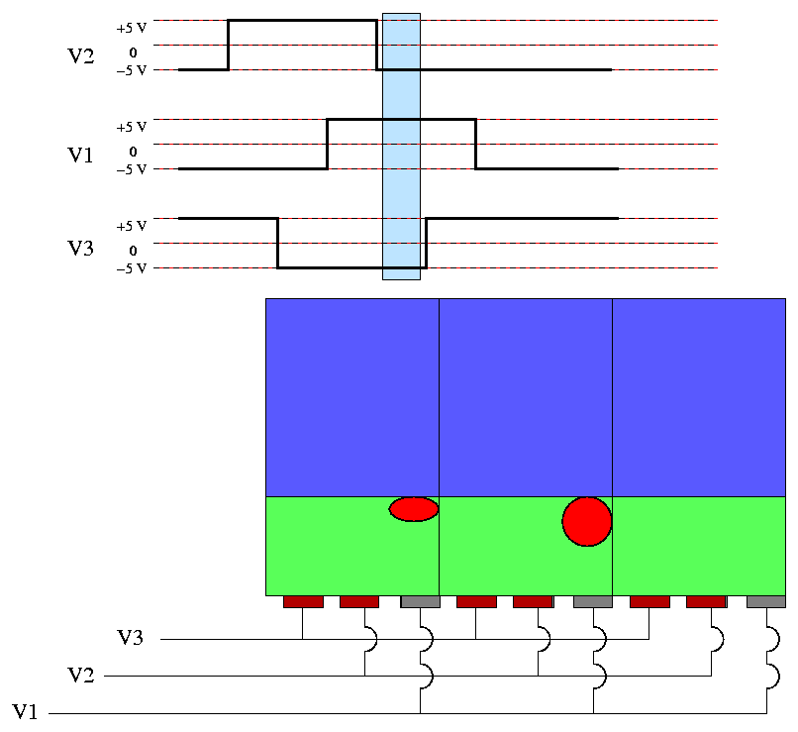
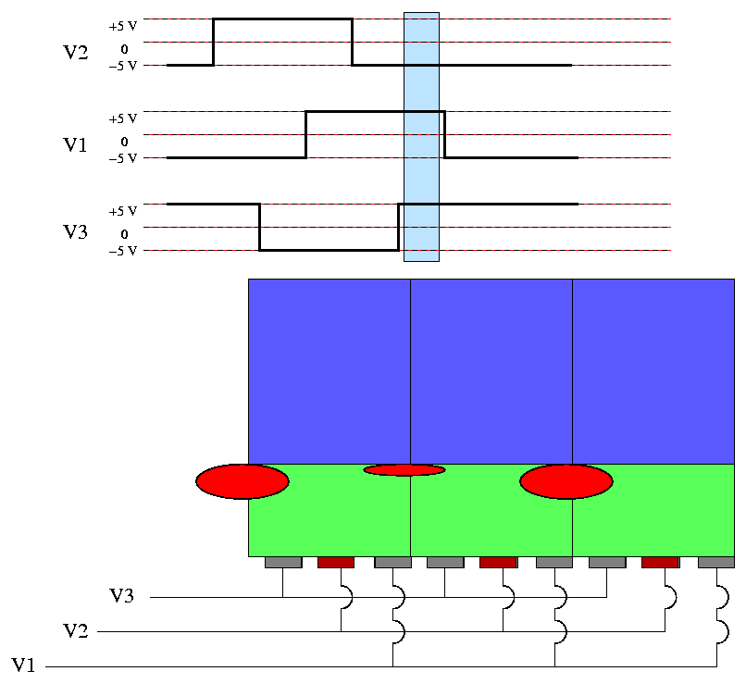
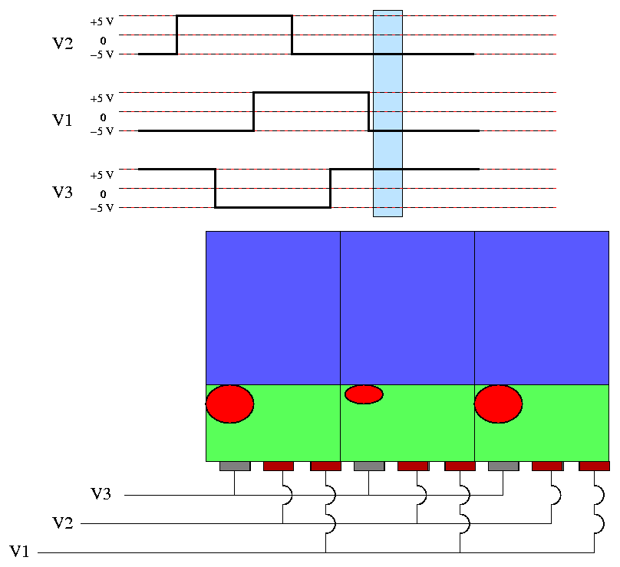
Three Phase Vertical Transfer Timing Model

Slide 22
Typical CCD Camera/System
+ 5V
- 7.5V
+ 15V
+ 5V
+ 5V
+ 5V
CCD Sensor
Horizontal Drivers
Raw Pixel Output
Pixel Buffer/AGC
Double Correlating A/D
Digital Output
+ 5V
Timing
Vertical Drivers
/Sync
+ 5V
+ 15V
Notes
Each Bock is an Individual Component/s.
Typically three Power Supply Voltages Required

Slide 23
FBI Appendix F Specs For AFIS
500 dots per inch
Must resolve 20 line pairs per mm at 10% MTF.

Slide 24
MTF Test Procedure
Illumination
MTF CURVE
Target
Linear System
Response
Spatial Frequency

Slide 25
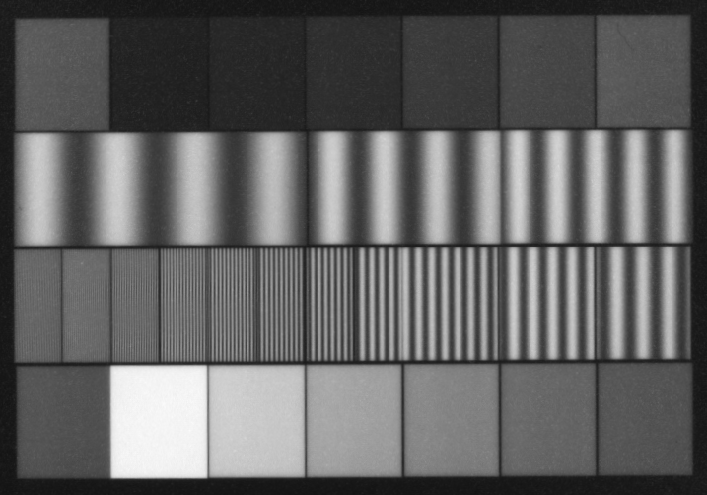
MTF Test Pattern

Slide 26
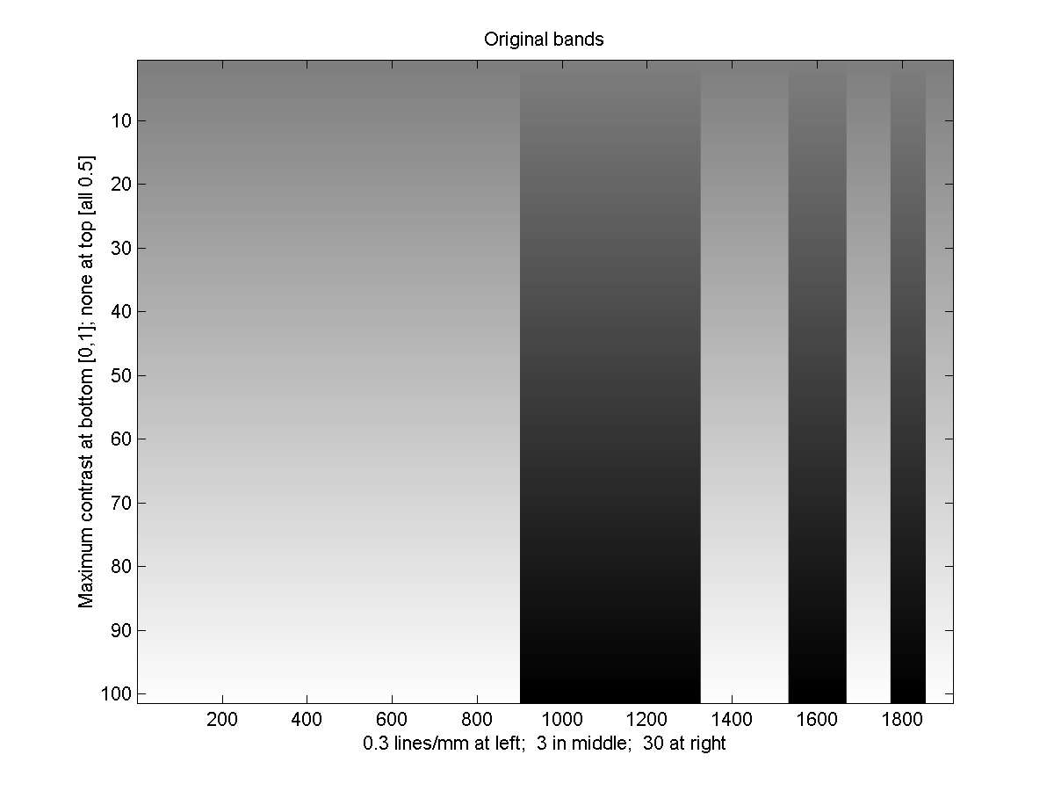
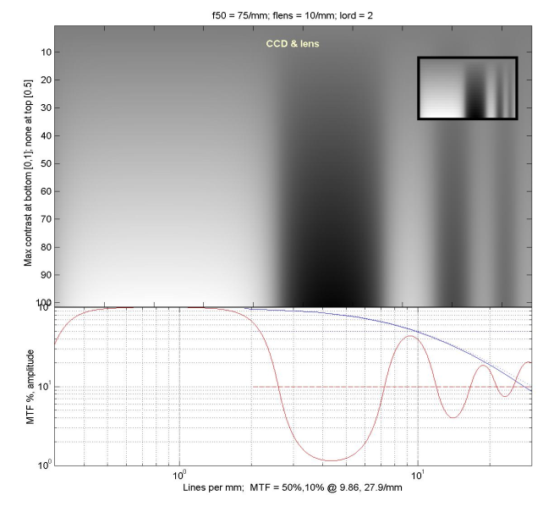
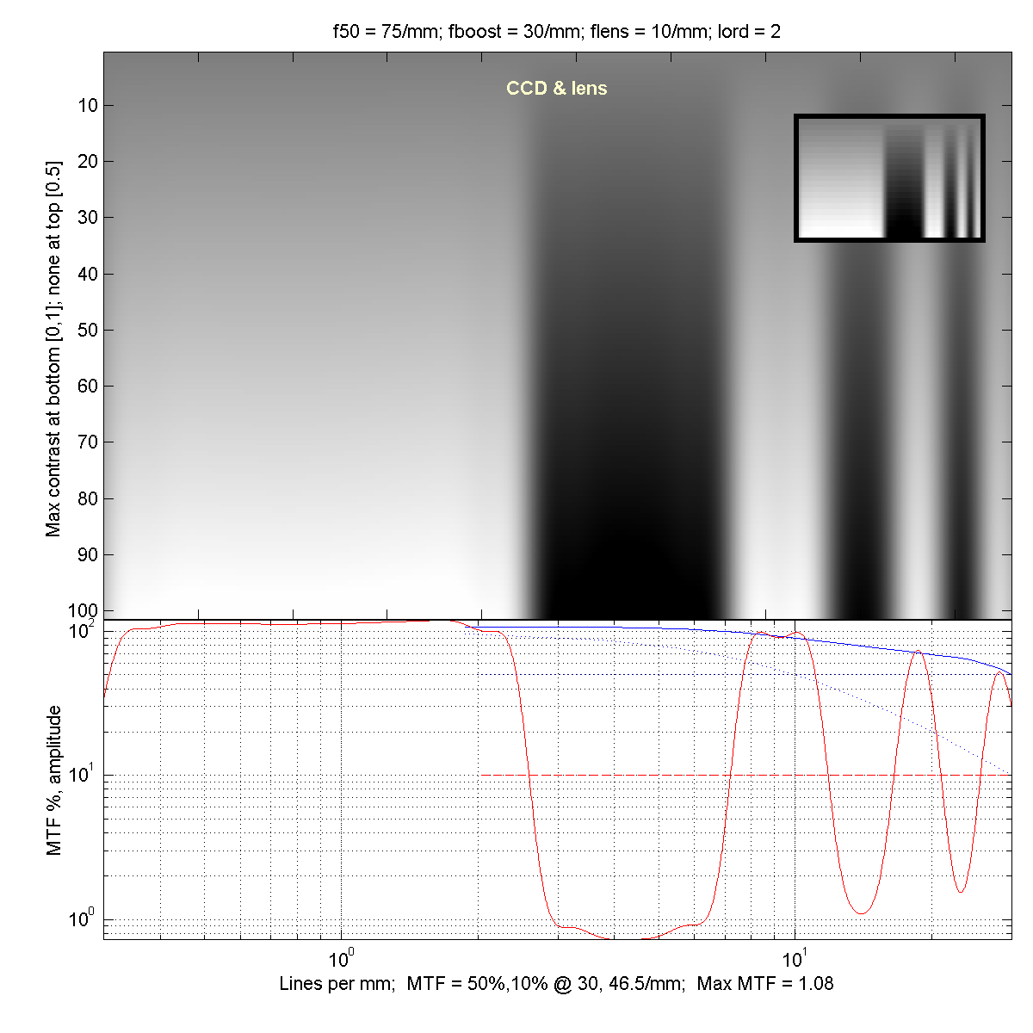
MTF Test Data

Slide 27
Results and Project Conclusions.
Camera received FBI certification.
Camera was integrated into TP 2000 later renamed to TP 3800.
First systems shipped in January 2002.
Identix shipped 20 systems per month in 2001-2002.
Identix merged with Visionics in 2/2002.

